Slide 1
The effect of number of clusters and cluster size on statistical power and Type I error rates when testing random effects variance components in multilevel linear and logistic regression models
Journal of Statistical Computation and Simulation
Peter C. Austin & George Leckie (2018)

Slide 2
Method
Use a series of Monte Carlo simulations to examine the effect of the number of subject per cluster on the statistical power and empirical type I error.

Slide 3
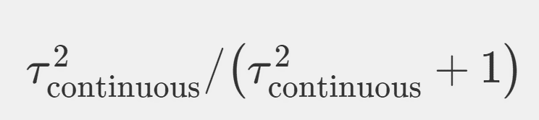
Scenarios
Inputs :
2 test : Likelihood Ratio Test & Wald Test
(for testing variance is different from zero or not.)
2 model : linear and logistic regression models
11 VPC : From 0 to 0.1 in increments of 0.01
19 number of clusters : 20 to 200 in increments of 10
4 cluster size : 10, 25, 50, and 100
VPC =

Slide 4
Scenarios
Outputs graphs:
Type I error
Power

Slide 5
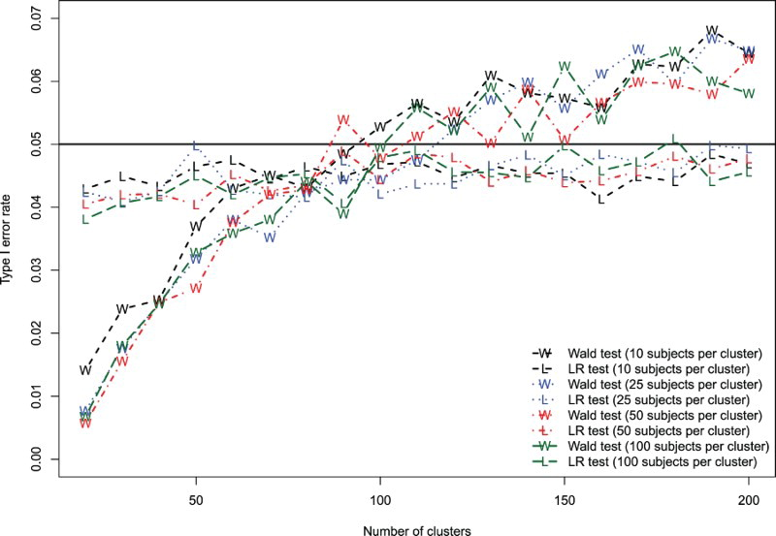
Effect of number of clusters on Type I error rate (linear model).

Slide 6
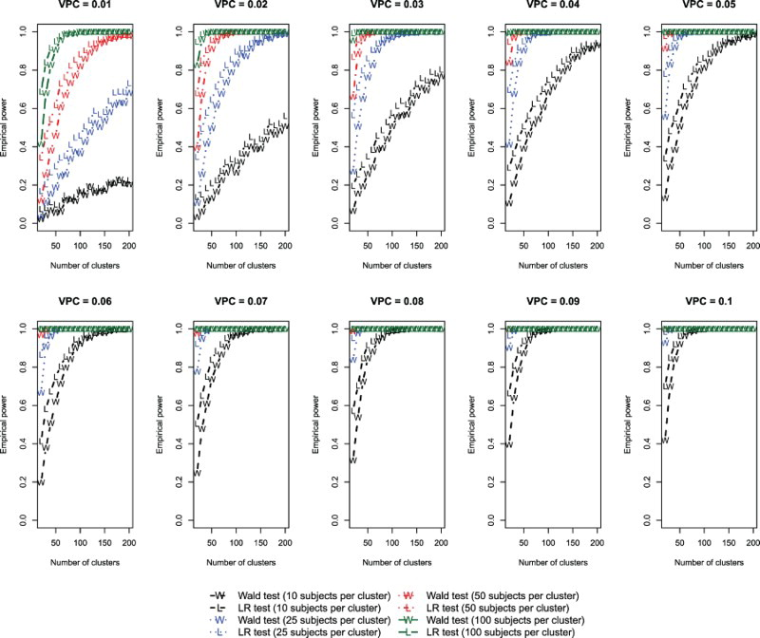
Effect of number of clusters on power to detect a non-zero variance (linear model).

Slide 7
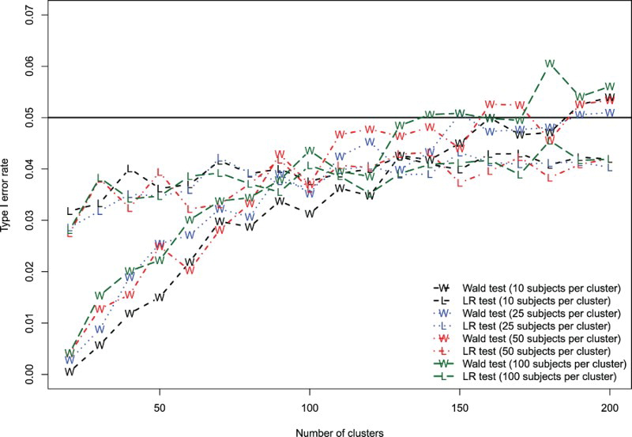
Effect of number of clusters on Type I error rate (logistic model).

Slide 8
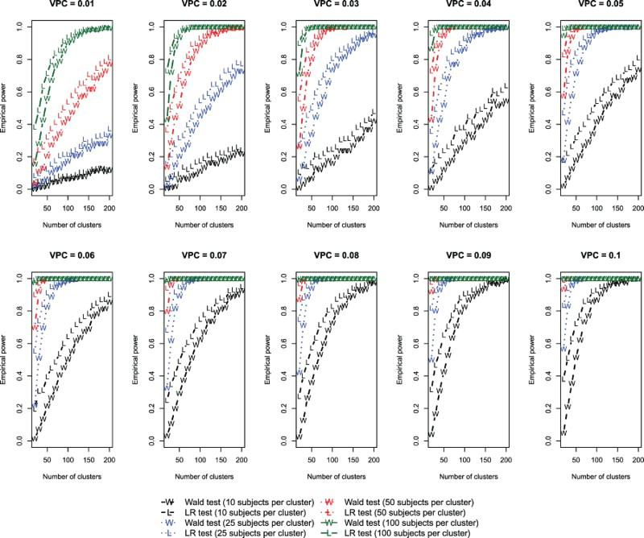
Effect of number of clusters on power to detect a non-zero variance (logistic model).

Slide 9
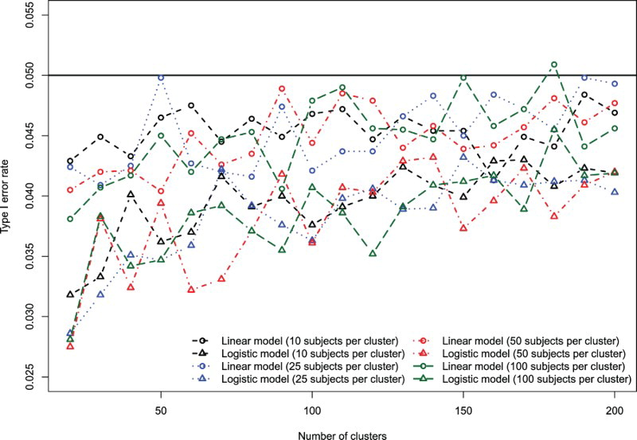
Comparison of LRT type I error rate: linear vs. logistic models.

Slide 10
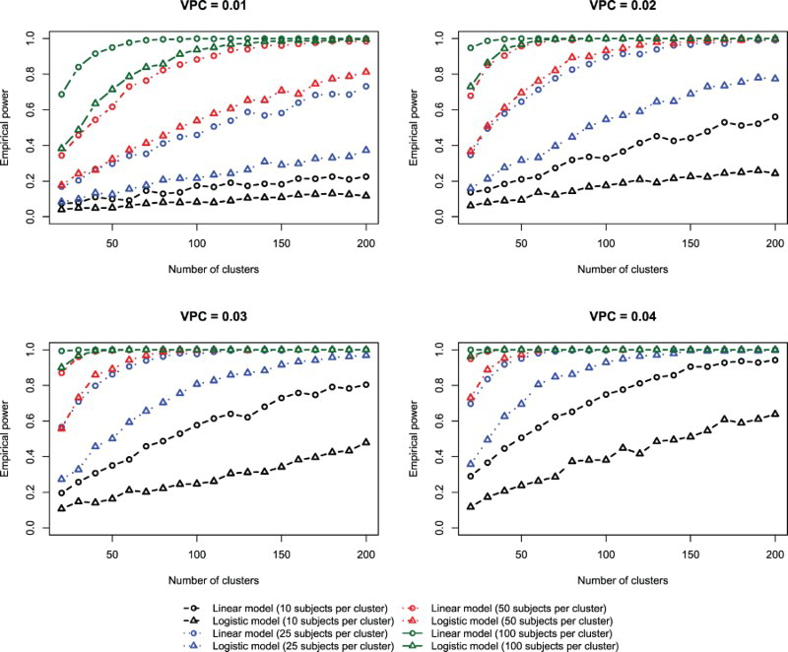
Comparison of LRT power for linear vs. logistic model.

